Slide 1
Deep Learning Learning Report

Slide 2
Overview
Learning Content
Paper List
Blog & Notes
Paper Comprehension
ChestX-ray8
SCAN

Slide 3
Learning Content
Time: 15th July. 2017 – 15th Aug. 2017
Caffe
Dependencies: ProtoBuffer, HDF5, LMDB …
Data structure: Blob, Layer, Net
CS231n (still under learning)
Forward/backward propagation
Segmentation, deconvolution
Dropout, BN
Paper: ChestX-ray8
Global pooling layer
ROC, AUC
Paper: SCAN
GAN
Segmentation: FCN, deeplab

Slide 4
Paper List
ChestX-ray8: Hospital-scale Chest X-ray Database and Benchmarks on Weakly-Supervised Classification and Localization of Common Thorax Diseases
SCAN: Structure Correcting Adversarial Network for Organ Segmentation in Chest X-rays
FCN: Fully convolutional networks for semantic segmentation
Deeplab: Semantic Image Segmentation with Deep Convolutional Nets, Atrous Convolution, and Fully Connected CRFs
GAN: Generative Adversarial Nets

Slide 5
Blog & Notes
Caffe 入门
https://blog.kinpzz.com/2017/07/30/Caffe-入门
[论文笔记] ChestX-ray8
https://blog.kinpzz.com/2017/08/02/notes-chestX-ray8/
[论文笔记] SCAN
https://blog.kinpzz.com/2017/08/09/notes-scan/
CS231n课程笔记
https://github.com/Kinpzz/Deep-Learning-on-Medical-Image/issues/2

Slide 6
ChestX-ray8
Paper Comprehension

Slide 7
ChestX-ray8
Introduction
Dataset
Constructing database
Framework
Model
Layer
Experiments
CNN
Performance
Sample
Conclusion

Slide 8
Introduction
Title
Hospital-scale Chest X-ray Database and Benchmarks on Weakly-Supervised Classiﬁcation and Localization of Common Thorax Diseases
Keyword
Weakly-Supervised
Multi-labels Classification and localization
Hospital-scale Chest X-ray Database (using NLP)
Background
A tremendous number of X-ray images with reports in hospital’s PACS
Related work on small-to-middle scale database
Pathology labels cannot be obtained through crowd-sourcing

Slide 9
Dataset
ChestX-ray8
108,948 frontal-view X-rays
32,717 unique patients
8 thoracic pathologies
Atelectasis（肺不张）
Cardiomegaly（心肥大）
Effusion（积液）
Infiltration（浸润）
Mass（肿块）
Nodule（结节）
Pneumonia（肺炎）
Pneumothorax（气胸）

Slide 10
Constructing Database
Tools
Dnorm, MetaMap
Noise problem: negated statements, uncertain mentions
NLP
Split and tokenize the reports into sentences using NLTK.
Parse each sentence by Bllip parser using David McCloskys biomedical model.
The syntactic dependencies are obtained from “CCProcesed” dependencies output by applying Stanford dependencies converter on the parse tree.
Processing Images
DICOM
Resized as 1024 x 1024 bitmap (OpenI: 512 x 512)
B-Box for pathologies
200 instances for each pathology
Annoted by a board-certified radiologist

Slide 11
Unified DCNN Framework

Slide 12
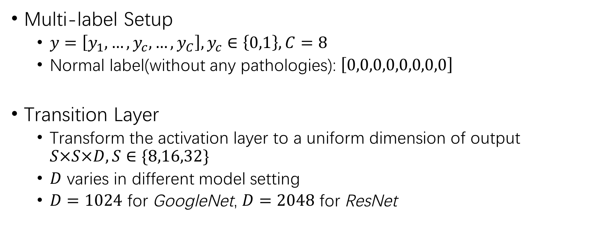
Layer
Multi-label Setup
$y=\left[y_{1},…,y_{c},…,y_{C}\right],y_{c}∈\left\{0,1\right\},C=8$
Normal label(without any pathologies): $\left[0,0,0,0,0,0,0,0\right]$
Transition Layer
Transform the activation layer to a uniform dimension of output $S×S×D,S∈\{8,16,32\}$
$D$ varies in different model setting
$D=1024$ for GoogleNet, $D=2048$ for ResNet

Slide 13
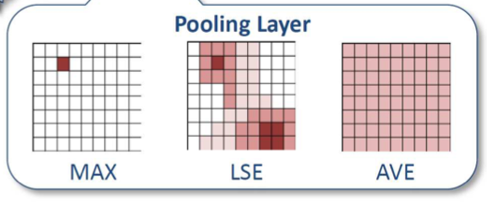
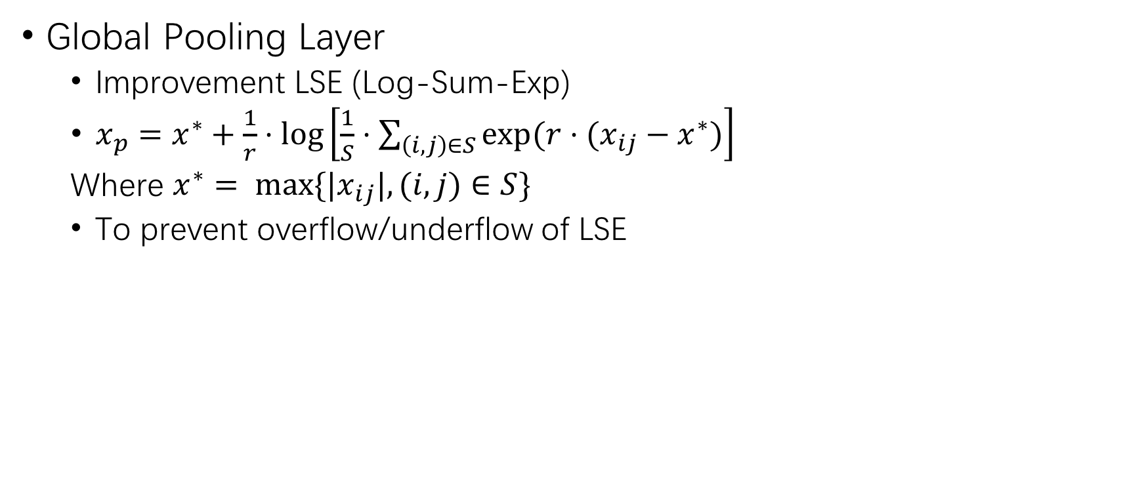
Layer
Global Pooling Layer
Improvement LSE (Log-Sum-Exp)
$x_{p}=x^{∗}+\frac{1}{r}⋅\log\left[\frac{1}{S}⋅\sum_{\left(i,j\right)∈S}{\exp{(r⋅(x_{ij}−x^{∗})}}\right]$
Where $x^{∗}= max⁡\{|x_{ij}|,(i,j)∈S\}$
To prevent overflow/underflow of LSE

Slide 14
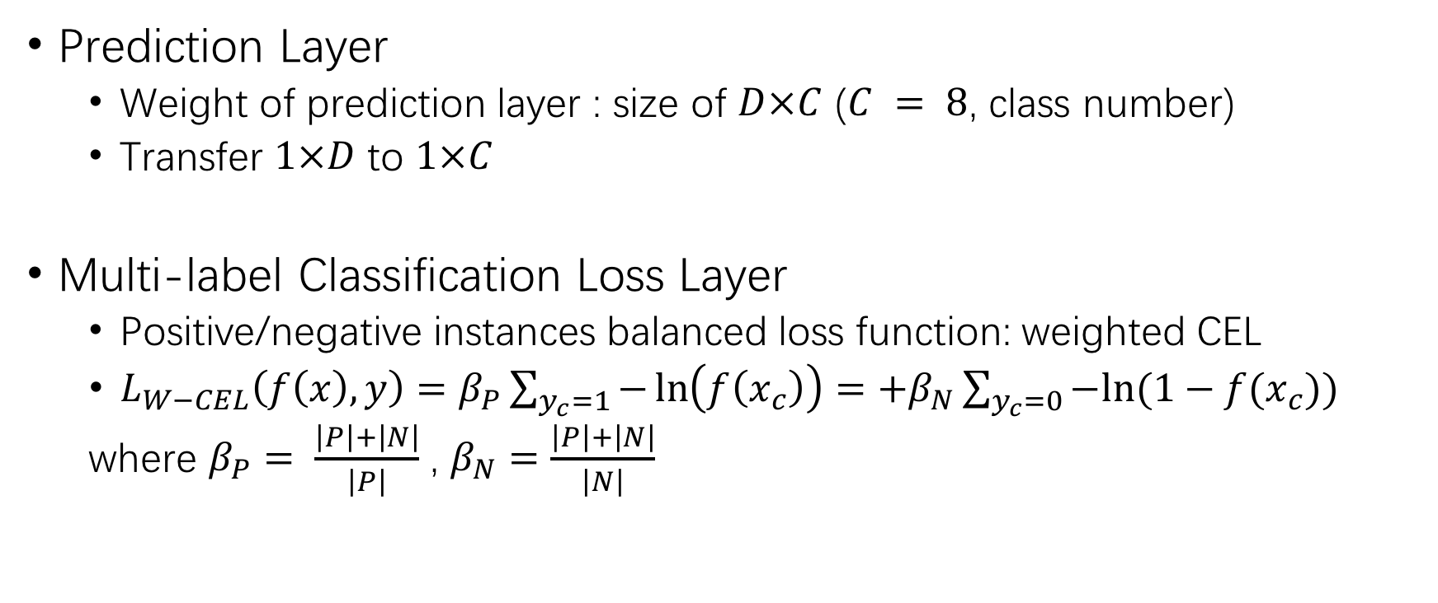
Layer
Prediction Layer
Weight of prediction layer : size of $D×C$ ($C = 8$, class number)
Transfer $1×D$ to $1×C$
Multi-label Classification Loss Layer
Positive/negative instances balanced loss function: weighted CEL
$L_{W−CEL}\left(f\left(x\right),y\right)=β_{P}\sum_{y_{c}=1}{−\ln\left(f\left(x_{c}\right)\right)}=+β_{N}\sum_{y_{c}=0}{−ln⁡(1−f(x_{c}))}$
where $β_{P}= \frac{\left|P\right|+\left|N\right|}{\left|P\right|}$ , $β_{N}=\frac{\left|P\right|+\left|N\right|}{\left|N\right|}$

Slide 15
B-Box
Heat map
Multiply activations form transition layer with weights from prediction layer
8 heat map for 8 diseases
B-Box
Normalized heat maps to [0,255]
Threshold heat map by {60, 180} individually (ad-hoc)
B-Boxes are generated to cover the isolated regions in the resulting binary maps

Slide 16
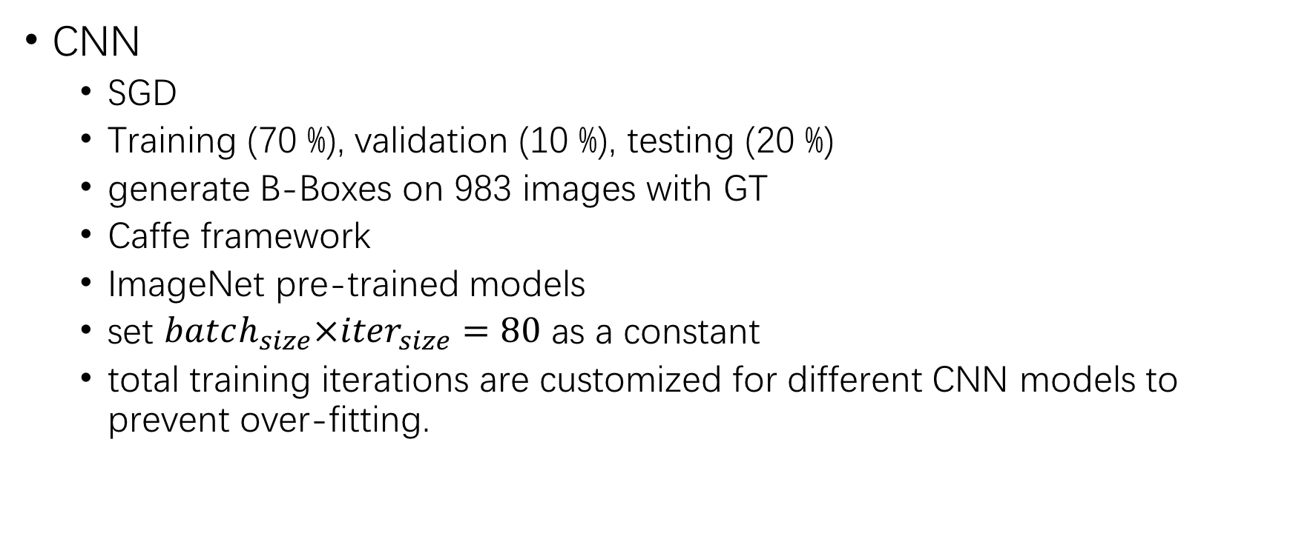
Experiment
CNN
SGD
Training (70 %), validation (10 %), testing (20 %)
generate B-Boxes on 983 images with GT
Caffe framework
ImageNet pre-trained models
set $batch_{size}×iter_{size}=80$ as a constant
total training iterations are customized for different CNN models to prevent over-fitting.

Slide 17
Performance
ROC and AUC
performance on four models
Mass : AUC=0.5609, huge within-class appearance variation
Pneumonia: AUC=0.6333, lack of total instances (less than 1%)

Slide 18
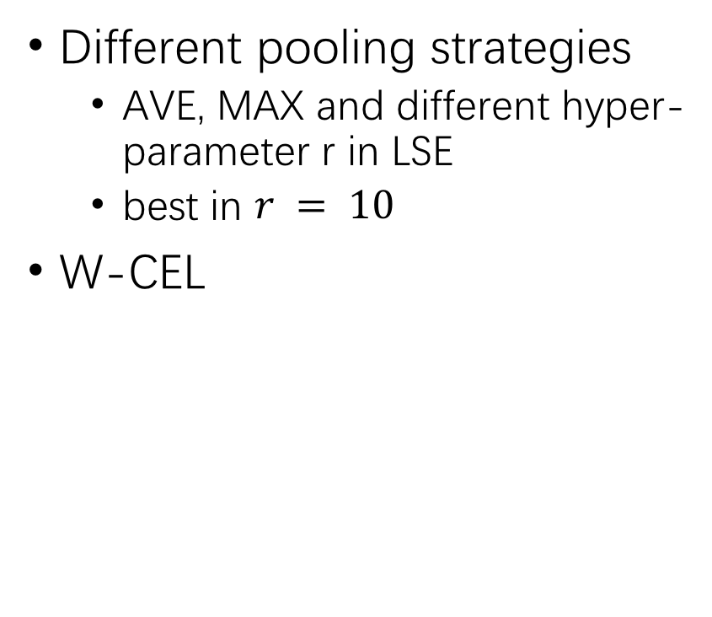
Performance
Different pooling strategies
AVE, MAX and different hyper-parameter r in LSE
best in $r = 10$
W-CEL

Slide 19
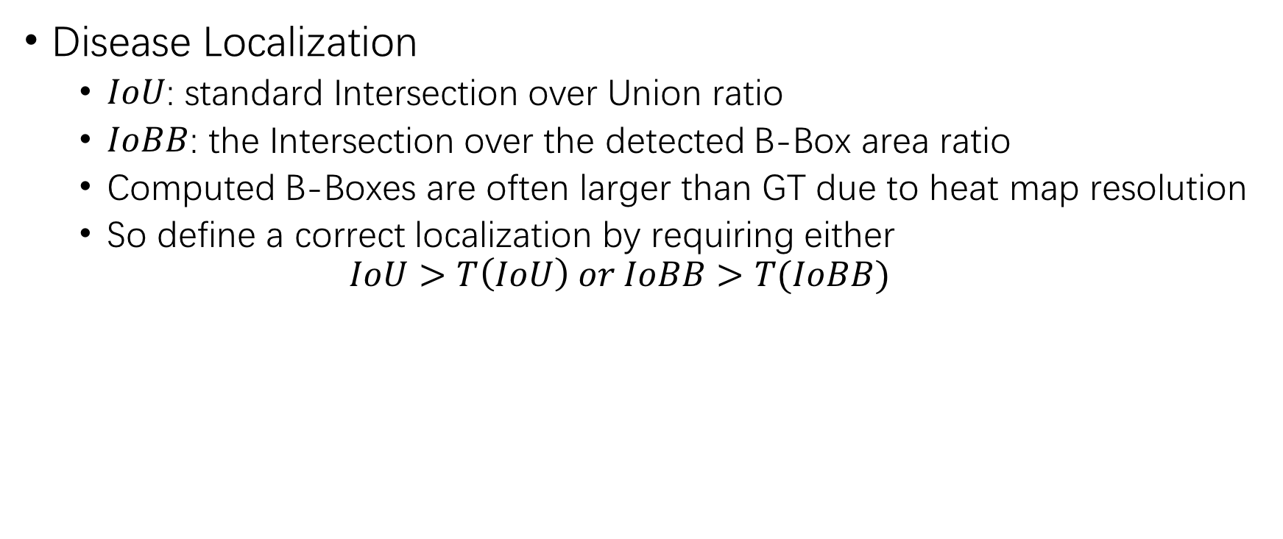
Performance
Disease Localization
$IoU$: standard Intersection over Union ratio
$IoBB$: the Intersection over the detected B-Box area ratio
Computed B-Boxes are often larger than GT due to heat map resolution
So define a correct localization by requiring either
$$IoU>T\left(IoU\right) or IoBB>T(IoBB)$$

Slide 20
Sample

Slide 21
Conclusion
Constructing hospital-scale radiology image databases with computerized diagnostic performance benchmarks
ChestX-ray8 can enable the data-hungry deep neural network paradigms to create clinically meaningful applications
These commonly occurring thoracic diseases can be detected and even spatially-located via a unified weakly-supervised multi-label image classiﬁcation and disease localization framework.
The main goal is to initiate future efforts by promoting public datasets in this important domain——Building truly large-scale fully-automated high precision medical diagnosis systems

Slide 22
SCAN
Paper Comprehension

Slide 23
SCAN
Introduction
Framework - SCAN
Training objectives
Segmentation Network
Critic Network
Experiments
Dataset
Processing
Performance
Conclusion

Slide 24
Introduction
Title
Structure Correcting Adversarial Network for Organ Segmentation in Chest X-rays
Keyword
Adversarial Network
Organ Segmentation
FCN
Background
Large amount of CXRs but very limited training data with annotations
Less information in CXRs
Organ segmentation is a crucial step to obtain effective computer-aided detection on CXR

Slide 25
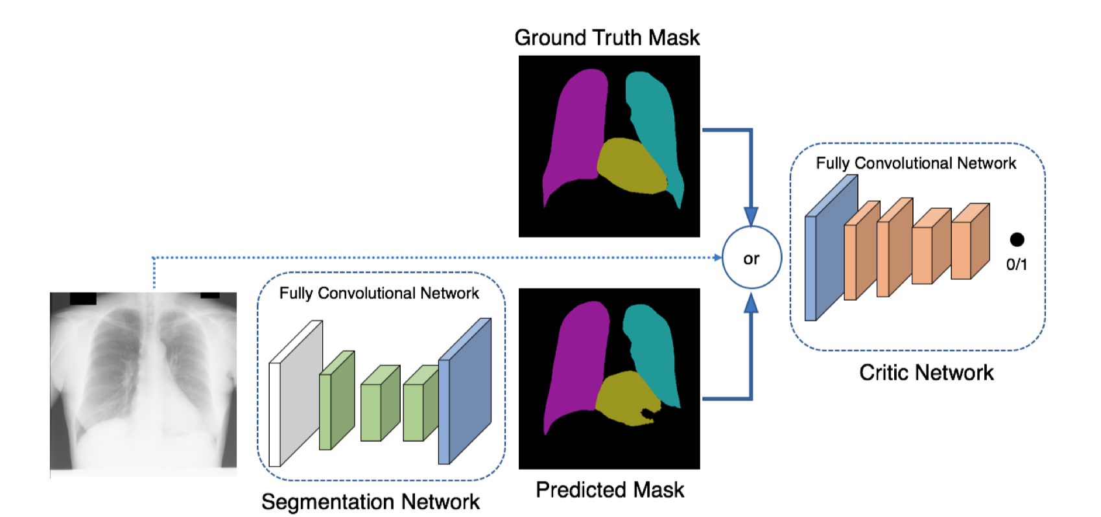
Structure Correcting Adversarial Network
Adversarial Network
A segmentation Network
A critic network

Slide 26
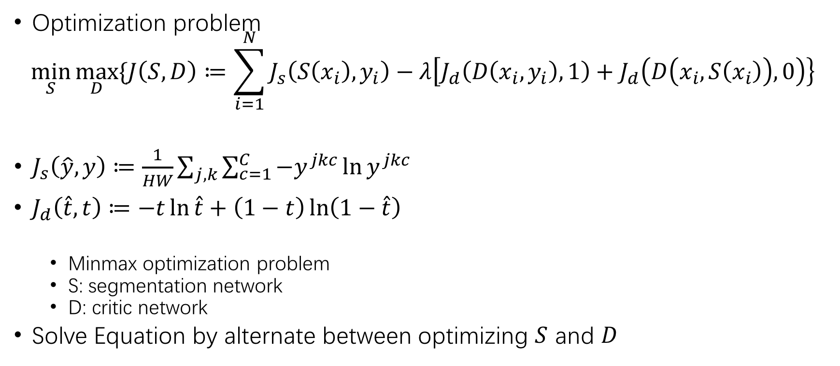
Training Objectives
Optimization problem
$$\min_{S}{\max_{D}{\{J\left(S,D\right)≔\sum_{i=1}^{N}{J_{s}\left(S\left(x_{i}\right),y_{i}\right)−λ\left[J_{d}\left(D\left(x_{i}, y_{i}\right), 1\right)+J_{d}\left(D\left(x_{i}, S\left(x_{i}\right)\right),0\right)\right\}}}}$$
$J_{s}\left(\hat{y},y\right)≔\frac{1}{HW}\sum_{j,k}{\sum_{c=1}^{C}{−y^{jkc}\ln{y^{jkc}}}}$
$J_{d}\left(\hat{t},t\right)≔−t\ln{\hat{t}+\left(1−t\right)\ln\left(1−\hat{t}\right)}$
Minmax optimization problem
S: segmentation network
D: critic network
Solve Equation by alternate between optimizing $S$ and $D$

Slide 27
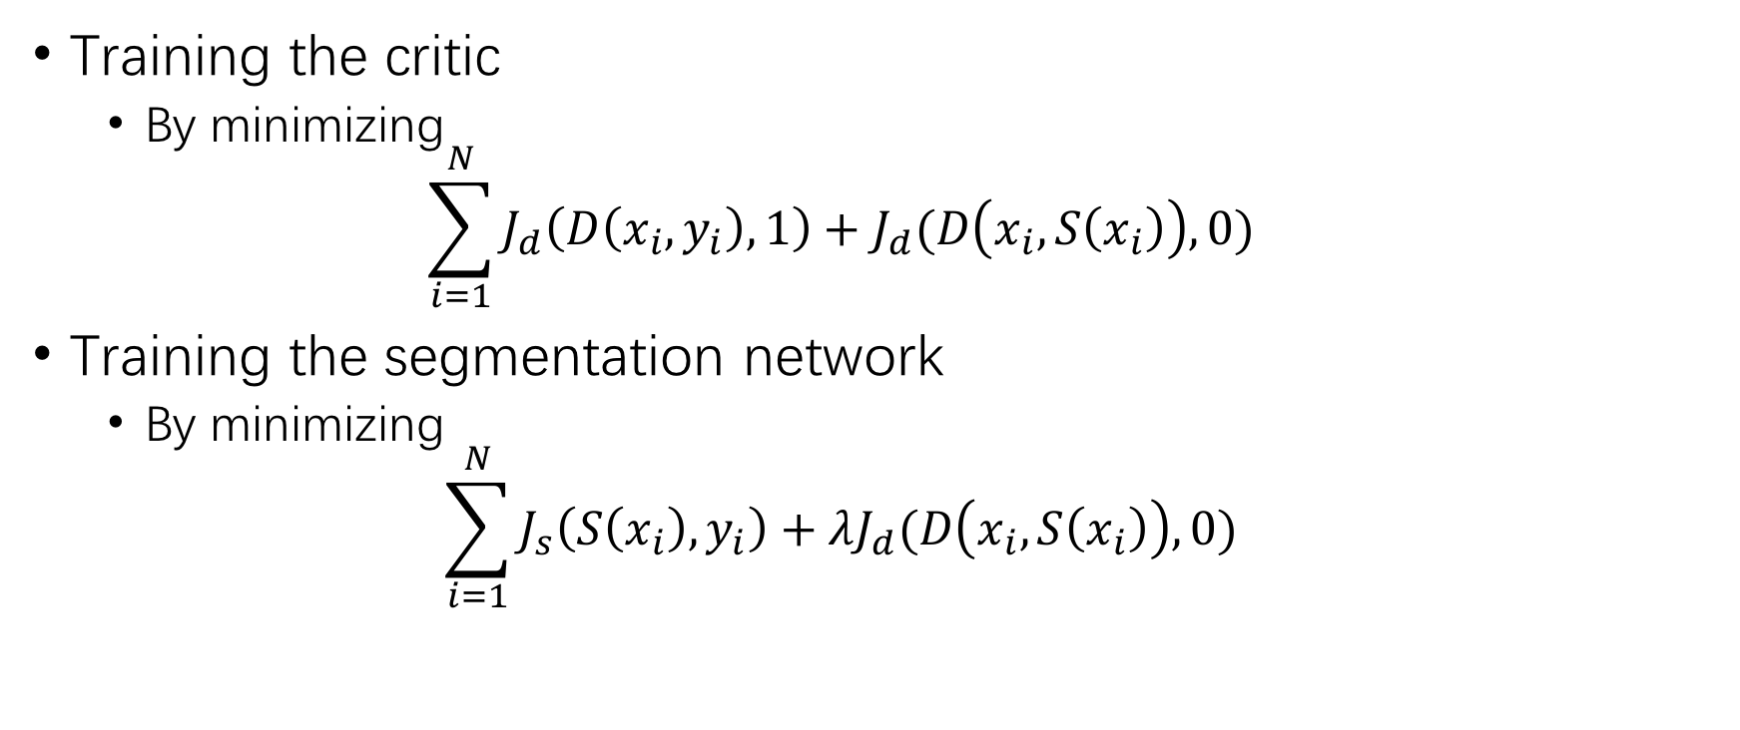
Training Objectives
Training the critic
By minimizing
$$\sum_{i=1}^{N}{J_{d}\left(D\left(x_{i},y_{i}\right),1\right)+J_{d}(D\left(x_{i},S\left(x_{i}\right)\right),0)}$$
Training the segmentation network
By minimizing
$$\sum_{i=1}^{N}{J_{s}\left(S\left(x_{i}\right),y_{i}\right)+λJ_{d}(D\left(x_{i},S\left(x_{i}\right)\right),0)}$$

Slide 28
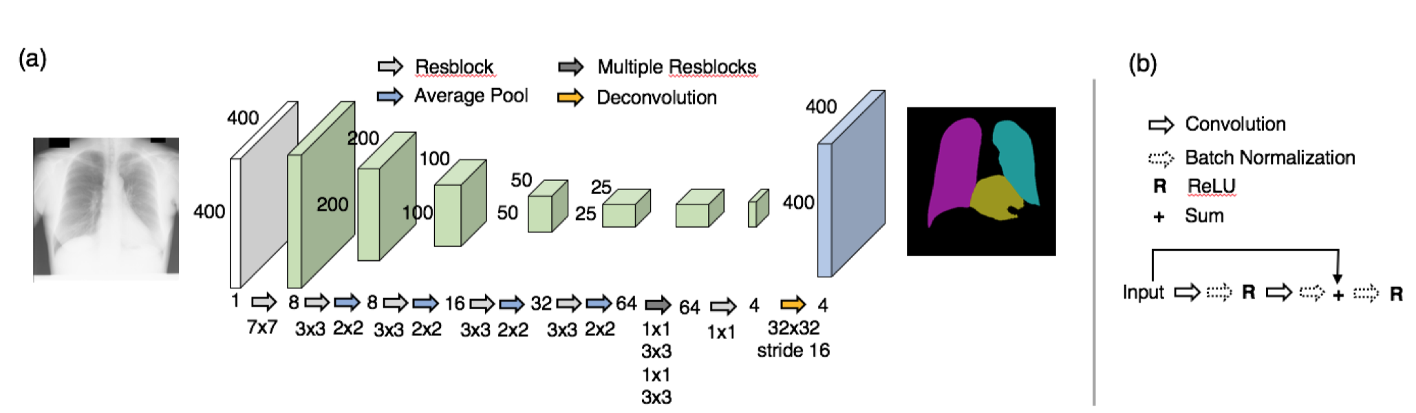
Segmentation Network
3 classes: the left/right lung, the heart
VGG-based FCN
Residual block

Slide 29
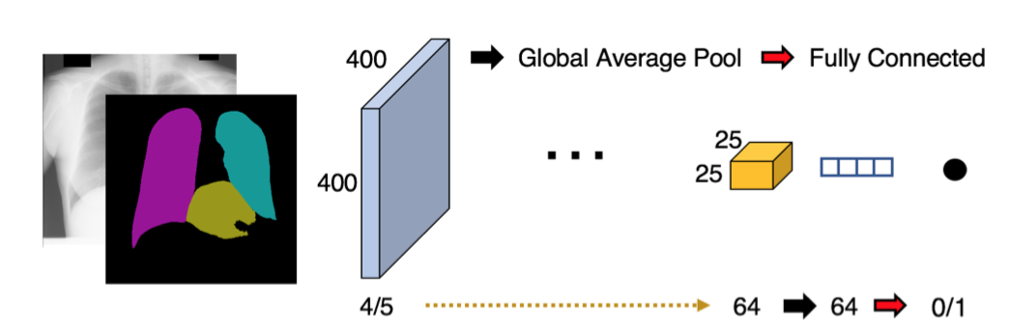
Critic Network
Input: 4/5 channels
Output: 0/1
0: from segmentation network
1: from ground truth
The same as
Segmentation network

Slide 30
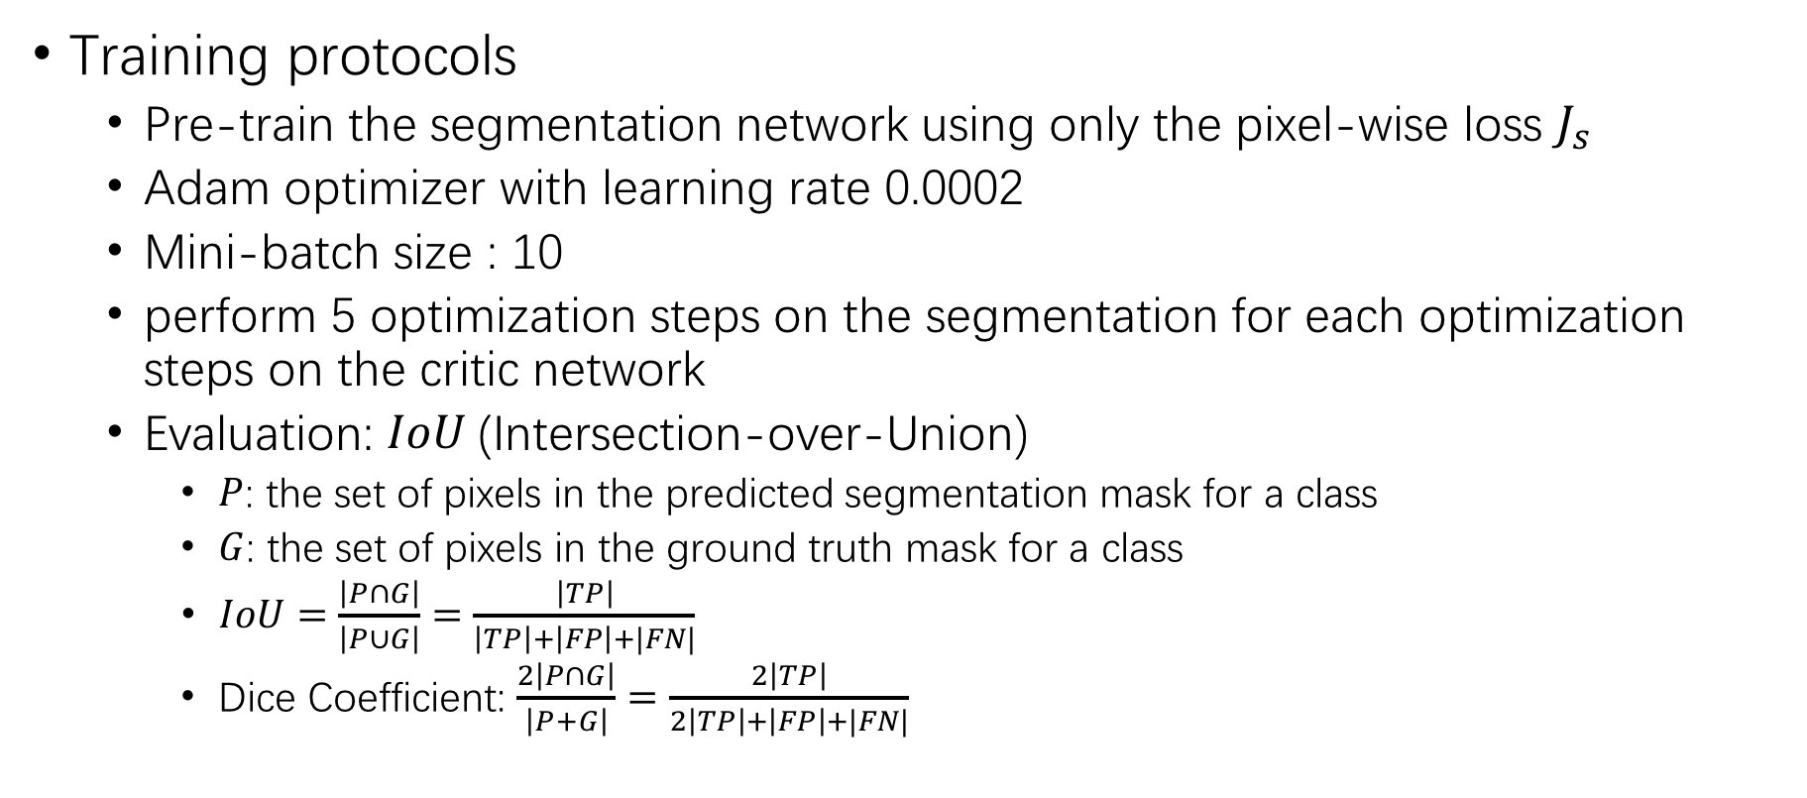
Experiments
Training protocols
Pre-train the segmentation network using only the pixel-wise loss $J_{s}$
Adam optimizer with learning rate 0.0002
Mini-batch size : 10
perform 5 optimization steps on the segmentation for each optimization steps on the critic network
Evaluation: $IoU$(Intersection-over-Union)
$P$: the set of pixels in the predicted segmentation mask for a class
$G$: the set of pixels in the ground truth mask for a class
$IoU=\frac{\left|P∩G\right|}{\left|P∪G\right|}=\frac{\left|TP\right|}{\left|TP\right|+\left|FP\right|+|FN|}$
Dice Coefficient: $\frac{2\left|P∩G\right|}{\left|P+G\right|}=\frac{2\left|TP\right|}{2\left|TP\right|+\left|FP\right|+|FN|}$

Slide 31
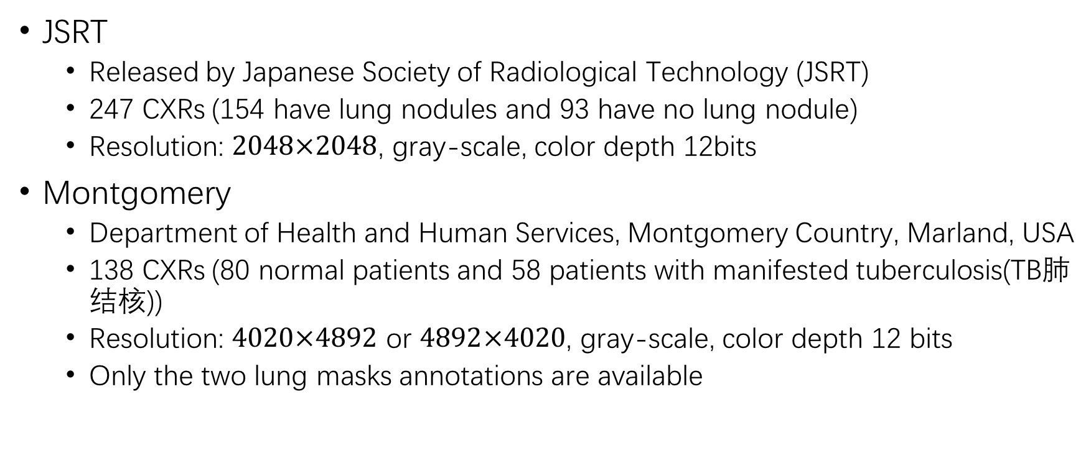
Dataset
JSRT
Released by Japanese Society of Radiological Technology (JSRT)
247 CXRs (154 have lung nodules and 93 have no lung nodule)
Resolution: $2048×2048$, gray-scale, color depth 12bits
Montgomery
Department of Health and Human Services, Montgomery Country, Marland, USA
138 CXRs (80 normal patients and 58 patients with manifested tuberculosis(TB肺结核))
Resolution: $4020×4892$ or $4892×4020$, gray-scale, color depth 12 bits
Only the two lung masks annotations are available

Slide 32
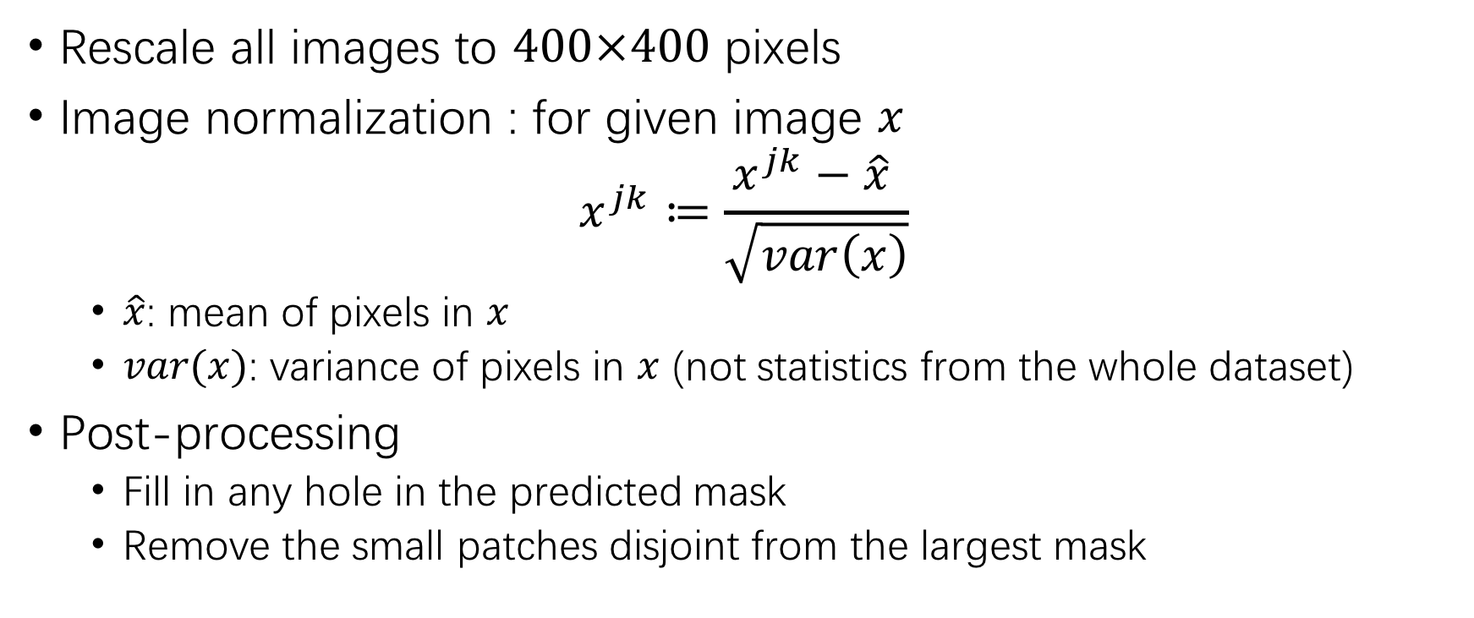
Processing
Rescale all images to $400×400$ pixels
Image normalization : for given image $x$ $x^{jk}≔\frac{x^{jk}−\hat{x} }{\sqrt{var\left(x\right)}}$
$\hat{x}$: mean of pixels in $x$
$var(x)$: variance of pixels in $x$ (not statistics from the whole dataset)
Post-processing
Fill in any hole in the predicted mask
Remove the small patches disjoint from the largest mask

Slide 33
Performance
Compare to current state-of-the-art
Registration-based method

Slide 34
Performance
Compare FCN with SCAN on JSRT (Table 1)
Compare SCAN to existing methods on JSRT (Table 2)

Slide 35
Performance
On different dataset
Train on the full JSRT and test on the full Montgomery

Slide 36
Performance
Time efficiency

Slide 37
Conclusion
Propose Structure Correcting Adversarial Network (SCAN) to segment lung fields and the heart in CXR images
The model produces highly accurate and natural segmentation
Surpass current state-of-the-art
Using only very limited training data available, the model reaches human-level performance without relying on any existing trained model or dataset
The first successful application of convolutional neural networks to CXR image segmentation

Slide 38
Thanks

